Slide 1

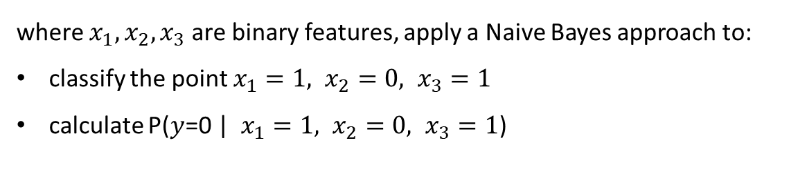
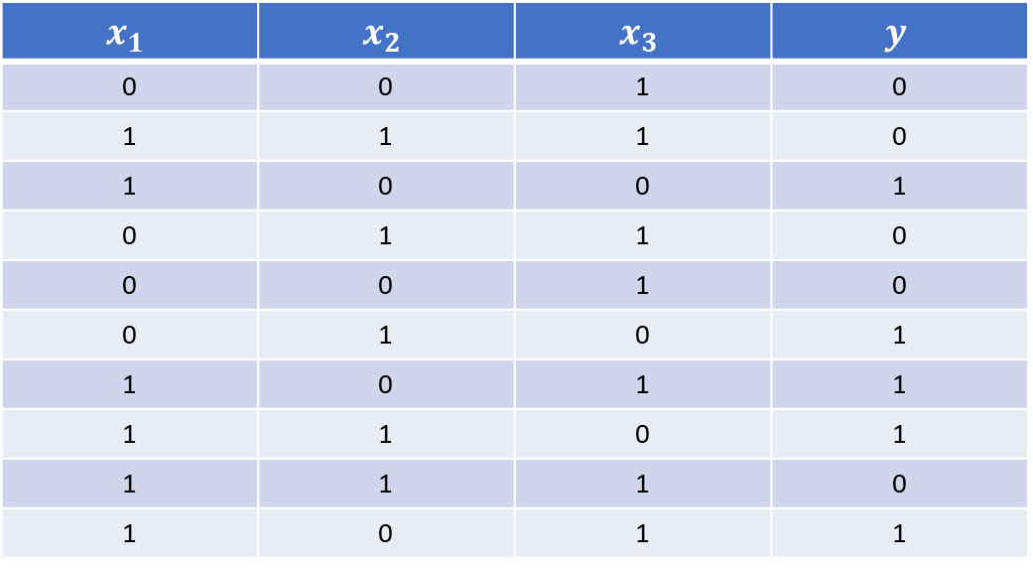
Exercise Naïve Bayes
Given the dataset:
$$x_{1}$$ | $$x_{2}$$ | $$x_{3}$$ | $$y$$
0 | 0 | 1 | 0
1 | 1 | 1 | 0
1 | 0 | 0 | 1
0 | 1 | 1 | 0
0 | 0 | 1 | 0
0 | 1 | 0 | 1
1 | 0 | 1 | 1
1 | 1 | 0 | 1
1 | 1 | 1 | 0
1 | 0 | 1 | 1
where $x_{1},x_{2},x_{3}$ are binary features, apply a Naive Bayes approach to:
classify the point $x_{1}=1, x_{2}=0, x_{3}=1$
calculate P($y$=0 | $x_{1}=1, x_{2}=0, x_{3}=1$)
Classroom exercise Naïve Bayes
Computation for Transportation Engineering – Hilary Term 2024

